Slide 1
FOODFIT
SUBMITTED BY,
ATHUL ABRAHAM
22PMC119

Slide 2
ABSTRACT
The Calorie Tracker is a software application that helps individuals monitor and manage their daily calorie intake. It aims to promote healthier eating habits and provide users with a tool to achieve their nutrition goals. The project involves developing a user-friendly web-based application with a comprehensive food database and features such as goal setting and progress tracking.

Slide 3
REQUIRMENTS
Registration and Login Page
Select Food
Add Food
Update Food.
Delete Food.
Profile Page
Calorie Calculations.

Slide 4
Features and highlight
Comprehensive Food Database: The system includes regularly updated food database that covers a wide range of food items.
Calorie Tracking: The Calorie Tracker Project allows users to log their food consumption and track their calorie intake effortlessly.
Goal Setting: The project enables users to set personalized calorie goals based on their weight management objectives, dietary requirements, or health goals.

Slide 5
Architecture
Presentation Layer:
User Interface (UI)
Django Templates
Jazzmin package
Application Layer:
Django
Django Views.
Django Forms.

Slide 6
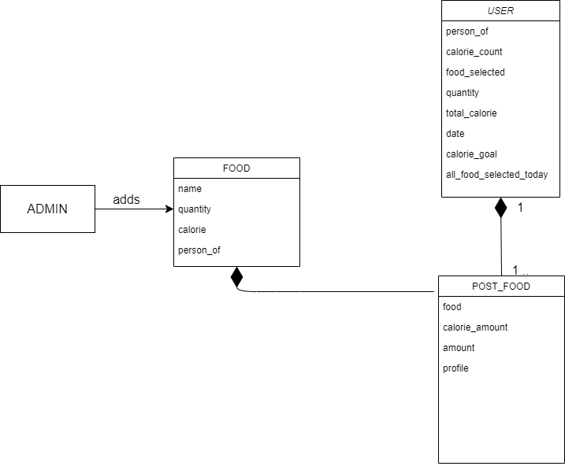
Class Diagram

Slide 7
Challenges faced during the development
Data Entry and Updating.
User Experience Design
Calorie Calculation Accuracy.

Slide 8
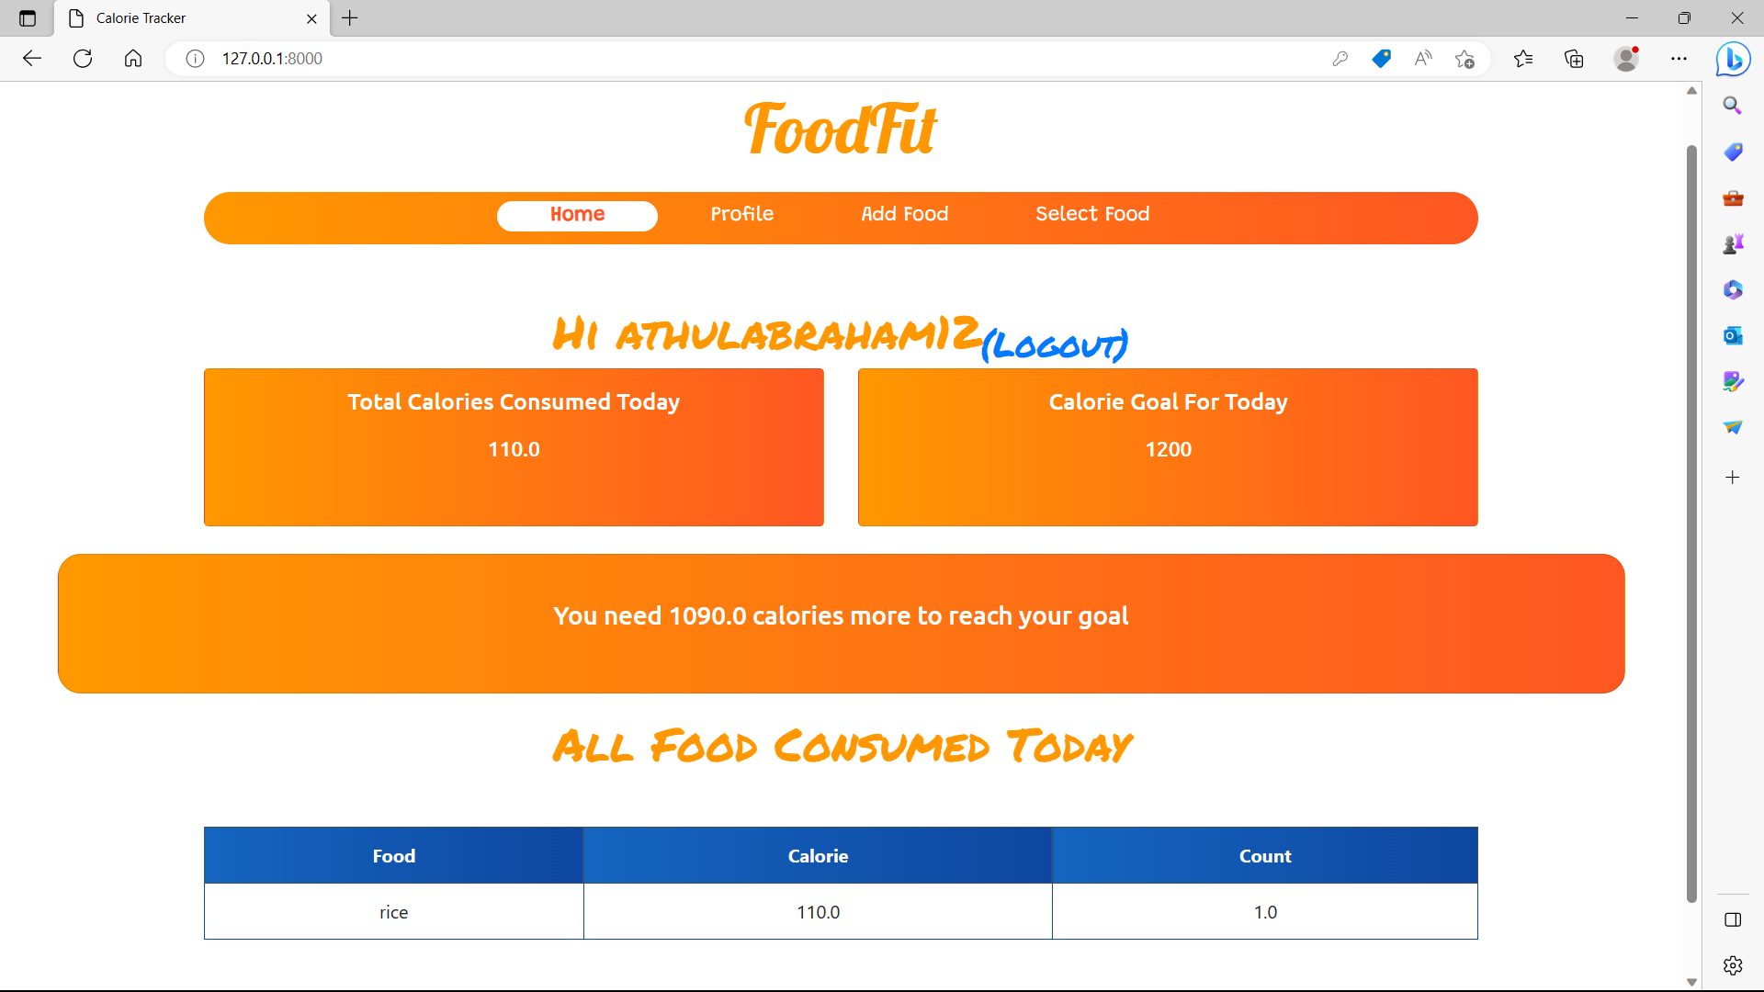
HOME PAGE

Slide 9
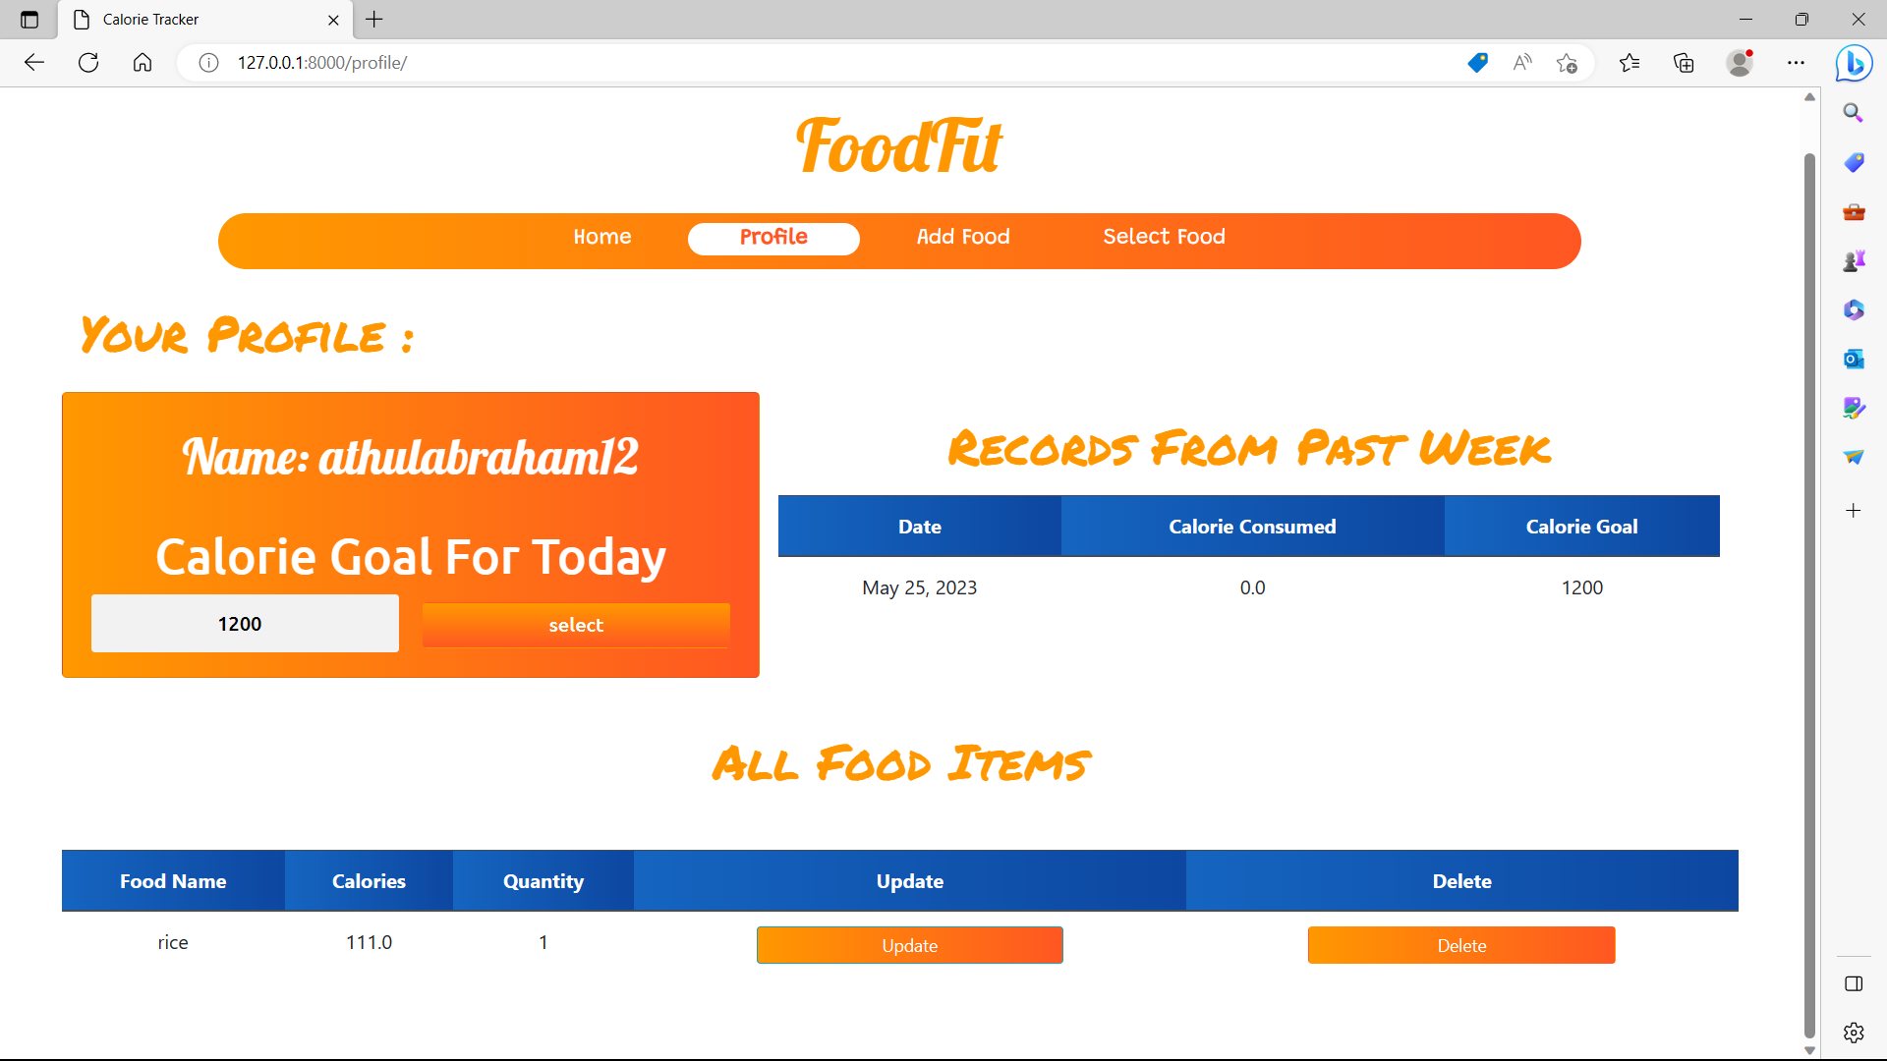
PROFILE

Slide 10
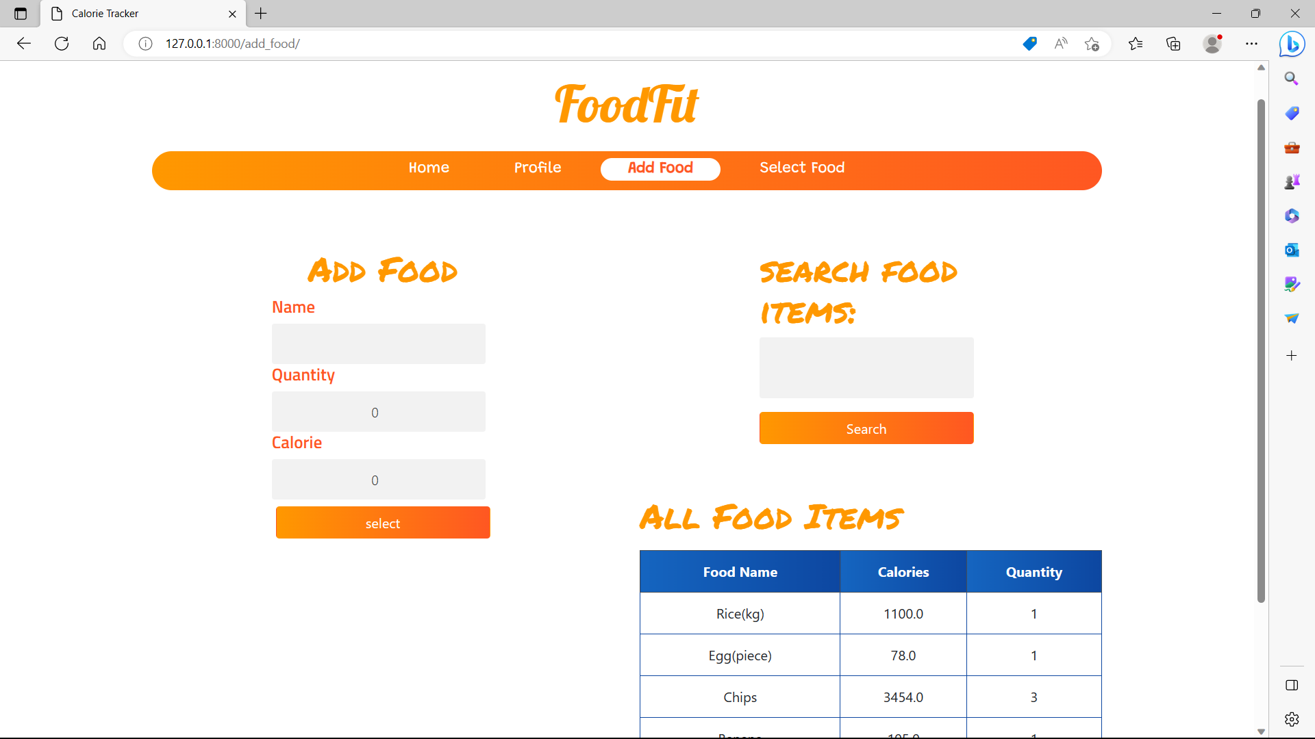
ADD FOOD

Slide 11
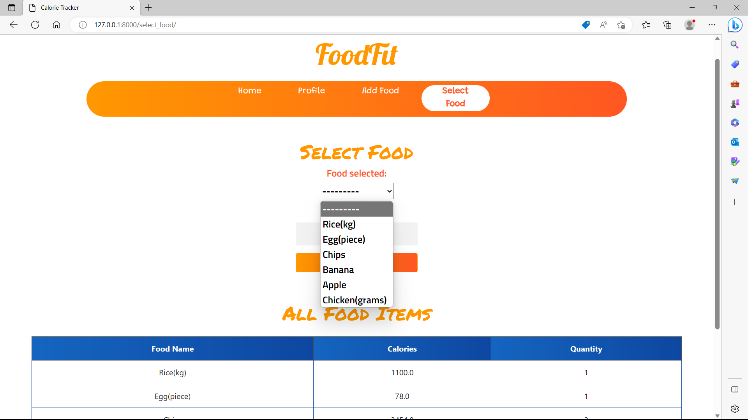
SELECT FOOD

Slide 12
Future enhancement
Integration with Fitness Apps: Integrating the calorie tracker with popular fitness apps or platforms would allow users to have a holistic view of their health and wellness journey.
Integration with Wearable Devices: Integrating the application with wearable devices, such as fitness trackers or smartwatches.

Slide 13
conclusion
The Calorie Tracker Project is a user-friendly software application that helps track and manage daily calorie intake. It promotes healthy eating habits, offers a comprehensive food database, accurate tracking and goal setting. Future enhancements aim to enhance the user experience and support health and wellness goals.

Slide 14
REFRENCES
Mayo Clinic - https://www.mayoclinic.org/
https://www.cdc.gov/

Slide 15
THANK YOU

